Slide 1


My sweet home. get ready
创作人：
魏改荣

Slide 2


01
认识我的甜蜜家园——房间与家具词汇学习
02
描述我的家——核心句型与位置表达
03
走进玲玲的家——故事语境中的语言实践
目录
04
我的创意之家——个性化表达与情感联结
05
巩固与拓展——儿歌、练习与综合运用
06
单元总结与情感升华——家是爱的港湾

Slide 3

01
My Sweet Home
Discover rooms, furniture, and the warmth of home

Slide 4

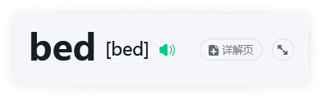



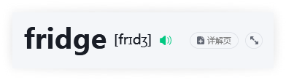
Core Home Items

Slide 5

Home Vocabulary: Chinese–English Match
1
Chinese & Icons
2
English & Pronunciation
■ living room 客厅 → 🛋️
■ bedroom 卧室 → 🛏️
■ kitchen 厨房 → 🍳
■ sofa 沙发 → 🪑
■ table 桌子 → 📋
■ bed 床 → 🛏️
■ chair 椅子 → 🪑
■ fridge 冰箱 → ❄️
Each icon visually anchors meaning — helping you connect words to real-world objects instantly.
■ living room [ˈlɪvɪŋ ruːm] n.
■ bedroom [ˈbedruːm] n.
■ kitchen [ˈkɪtʃɪn] n.
■ sofa [ˈsəʊfə] n.
■ table [ˈteɪbəl] n.
■ [bed] n.bed
■ chair [tʃeər] n.
■ fridge [frɪdʒ] n.
★ Tip: fridge is short for refrigerator — used daily in spoken English!

Slide 6

Describe My Home
02
Core sentence patterns & spatial prepositions

Slide 7
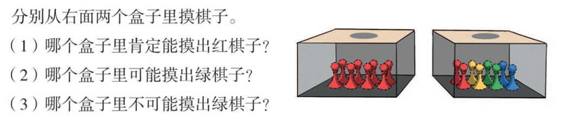

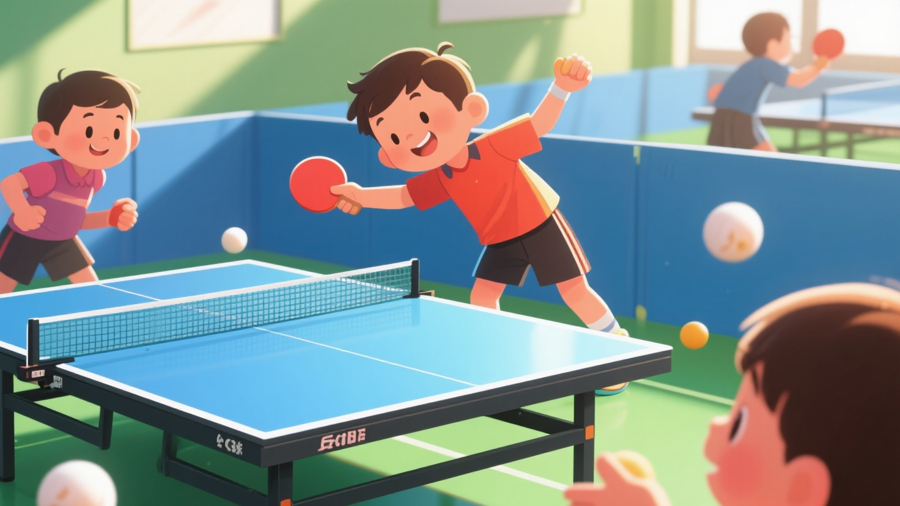
Where Is It? Understanding in / on / under
in — enclosed space
on — surface contact
under — below and covered
★ means inside a container or enclosed areain
→ The cat is in the box.
→ The milk is in the fridge.
→ There’s a book in the bag.
★ means resting atop a surface→ The book is
on the table.→ Her phone is
onon the sofa.→ A lamp is on
the desk.
★ under means directly beneath and often hidden
→ The ball is under the chair.
→ His shoes are under the bed.
→ The keys are under the newspaper.

Slide 8




Slide 9
Enter Lingling's Home
03
A story-based language journey to discover rooms, furniture and love

Slide 10
Rooms & Their Functions
1
Living Room — Heart of the Home
2
Kitchen — Hub of Life & Care
■ The kitchen is where meals are prepared, family traditions are passed down, and care is expressed through food.
■ Typical items: , stove, sink, cabinets, dining table (often adjacent).■ Key sentence:
The fridge is in the kitchen.fridge■ Why it matters: It symbolizes nourishment, safety and daily rhythm — the quiet engine of home life.
■ Real-world link: In Lingling’s story, she finds Susu near the fridge — because cats love cool, quiet corners and the smell of food!
■ The is where family gathers, relaxes and entertains guests.■ Typical items:
sofa, table, chair, TV, bookshelf.■ Key sentence: The sofa is in the living room.
living room■ Why it matters: It reflects warmth, connection and shared moments — not just furniture, but feelings.
■ Fun fact: In many Chinese homes, the living room also serves as a space for greeting elders and celebrating festivals — making it culturally rich and emotionally central.

Slide 11










Slide 12
My Creative Home
04
Personalized expression & emotional connection

Slide 13




Introduce My Drawn Home
Sentence Frames
■ I have… → I have a sofa in the living room.
I have a bed in the bedroom.
I have a fridge in the kitchen.
■ This is my… → This is my bedroom. It’s cozy and bright.
This is my kitchen. We cook delicious meals here.
This is my living room. We watch movies and laugh together.
Visual Cues
★ sofa → 🛋️
★ table → 🪵
★ bed → 🛏️
★ chair → 🪑
★ fridge → ❄️
★ kitchen → 🍳
★ bedroom → 🌙
★ living room → 📺
Expression Tips
➤ Use adjectives to add feeling: cozy, warm, colorful, quiet, sunny, tidy
➤ Add people or activities: We eat breakfast together. My cat sleeps on the sofa.
➤ Connect space and emotion: My bedroom is my safe place. The kitchen smells like home.

Slide 14


Slide 15
05
Consolidation & Extension
Songs • Practice • Real-life Application

Slide 16


Draw and Say: My Home
📝 Your Task
① Draw your home on the printable outline — include at least one living room, bedroom, and kitchen.
② Label 3 key items (e.g., sofa, bed, fridge) with English words.
③ Say aloud using these sentence frames:
💬 Sentence Frames
→ This is myliving room.→
There is asofain theliving room.→ I like the
bedroombecause it’s cozy.
🎨 Student Example
→ A real Grade 3 student’s drawing with speech bubble: “This is my kitchen. There is a fridge in the kitchen. I like the kitchen because we eat yummy food!”

Slide 17
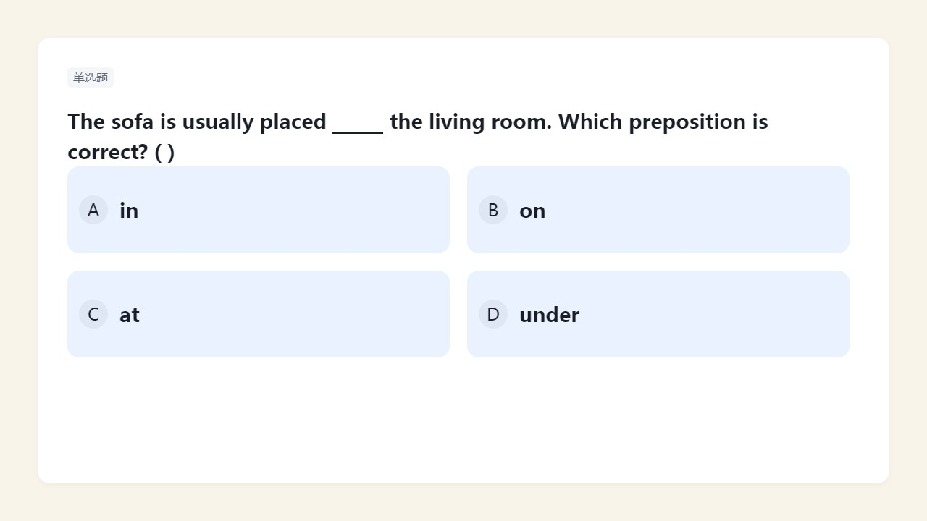


Slide 18
06
Home Is Love's Harbor
Unit Summary & Emotional Reflection — Where Heart Finds Its Anchor

Slide 19

What Makes a Home Sweet?
★ Core Idea: A home is not just a place—it’s where love lives, safety grows, and belonging begins.
➤ Emotional Anchors of Home:
① Unconditional acceptance — You can be yourself without fear of judgment
② Shared rituals — Family dinners, weekend walks, holiday traditions
③ Emotional safety — Knowing you’ll be supported through failure or change
④ Intergenerational connection — Stories, values, and warmth passed across ages
※ Think deeply: Which moment made your home feel most 'sweet' this year? Why did it matter?

Slide 20



My Home Is… Because…
Cozy & Connected
Resilient & Rooted
Quietly Sacred
My home is because silence there doesn’t mean emptiness — it means breathing space. The creak of the floorboard upstairs, the hum of the fridge at midnight, the way sunlight pauses on the bookshelf every 4:17 p.m. — these are our sacred rhythms.sacred
My home is cozy because we laugh together — even over burnt toast and silly arguments. Warmth isn’t in the heater; it’s in how my little brother copies my voice, and how Mom always saves the last cookie for me.
My home is resilient because we rebuild after storms — literal and emotional. When Dad lost his job, we turned the living room into a board-game café. We didn’t have much money, but we had time, trust, and playlists we made together.

Slide 21
谢谢大家

