Slide 1



《Module 9 Unit 1 Are you feeling bored?》
创作人：
厚芳芹

Slide 2

目录
01
情绪词汇学习与感知
02
询问他人感受的核心句型实践
03
真实情境中的情绪表达与回应
04
情绪对话综合运用与角色体验
05
知识巩固与互动检测
06
单元总结与情感表达迁移

Slide 3

01
Emotion Vocabulary Exploration
感知心情 · 描绘内心 · 用英语表达真实自我

Slide 4

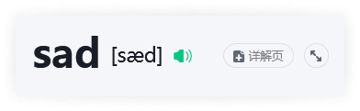
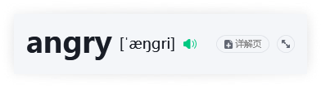
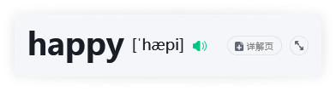
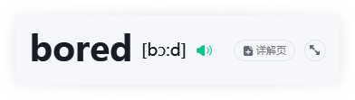
Core Emotion Adjectives

Slide 5

The Verb 'Feel': Expressing Inner States
1
Structure & Grammar
2
Real-Life Contexts
■ feel functions as a linking verb, connecting the subject to an adjective that describes its emotional or physical state — not an action.
■ Subject–Verb Agreement: I/you/we/they feel; he/she/it feels. Note the -s ending in third person singular.
■ This structure emphasizes internal experience: I feel tired ≠ I am tired (the former highlights awareness of the state).
■ Common collocations: feel happy/sad/bored/angry/excited/nervous/confident.
→ Examples: She feels anxious before exams. They feel relieved after passing the test. I feel proud of my progress.
■ After an exam: "I feel nervous but also hopeful."
■ On a rainy weekend: "We feel bored at home — no plans, no friends around."
■ During class participation: "When called to answer, he feels embarrassed but tries anyway."
■ Receiving good news: "She feels thrilled — her application was accepted!"
■ Missing someone: "He feels lonely since moving abroad."
These examples reflect authentic teenage experiences — emotionally nuanced, grammatically accurate, and socially relevant for high school learners.

Slide 6
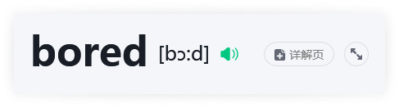
bored: Pronunciation & Semantic Precision

Slide 7
02
Ask How Others Feel
Master essential question patterns for emotional connection

Slide 8

Yes, I am. / No, I'm not.
■ Structure & Logic 结构与逻辑：
✓ — used to affirm a question with 'Are you...?' (肯定回答‘Are you...?’句型)✓ — the standard contracted negative response (标准缩略否定应答)
■ Pronunciation & Intonation 发音要点：① [aɪm] — /m/ sound is clear and connected to next word
② [nɒt] — /ɒ/ is short and open; stress falls on 'not' in emphasis
③ Rising intonation for questions, falling for answers → (↘),
(↘)■ Real-life Examples 真实例句：— Are you feeling tired? → Yes, I am. I stayed up late studying.
Yes, I am.— Are you feeling excited about the trip? → No, I'm not. I’m actually nervous.No, I'm not.
I'mnot— Are you feeling okay today? → Yes, I am. Thanks for asking!
Yes, I am.— Are you feeling bored in class? → No, I'm not. This lesson is interesting!
No, I'm not.

Slide 9



Careful Questions & Empathetic Responses
What's the matter?
■ Meaning & Use 意义与使用：
A polite, caring way to ask about someone’s problem or discomfort — more natural than 'What’s wrong?' in formal or sensitive contexts.
→ Used when noticing visible signs: frowning, silence, tired eyes, or quiet behavior.
■ Examples & Nuance 例句与语气：
① What's the matter? You look pale. → Gentle concern (轻声关切)
② What's the matter? Did something happen at school? → Supportive follow-up (支持性追问)
③ What's the matter? Is it your leg again? → Familiar & empathetic (熟悉且共情)
I'm so sorry.
■ Function & Weight 功能与分量：
Expresses sincere sympathy — stronger and warmer than 'I'm sorry.'; 'so' intensifies emotional weight.
→ Never used for minor inconveniences (e.g., dropping a pen); reserved for real hardship, loss, or pain.
■ Contextual Pairings 场景搭配：
① I'm so sorry. Your grandmother is ill in hospital. → Acknowledges gravity
② I'm so sorry. That test was really hard — I know you studied hard. → Validates effort & emotion
③ I'm so sorry. You missed the trip because of the fever. → Recognizes personal loss

Slide 10
03
Real-Life Emotion Expressions
When feelings speak — understanding how we truly connect

Slide 11
Contextual Meaning of Key Phrases
1
be ill in hospital
2
miss your friends / call your mum
■ Function & Perspective：Third-person, formal/neutral reporting — used to describe someone else’s medical condition objectively
■ Grammar Note：‘be ill’ is a state (not action); ‘in hospital’ = UK English (US: ‘in the hospital’)
■ Examples：
① My cousin is ill in hospital after the accident. (reporting fact, no personal emotion)
② The doctor said she’ll stay for another week. (professional context)③ We visited him because he
was ill in hospitalill in hospital last month. (past reference with clear time marker)※ Not used for self-reference in spontaneous speech: ✗ 'I am ill in hospital' → ✓ 'I’m in hospital' or 'I’m unwell'.
■ miss your friends：First-person, subjective emotional state — expresses longing, often tied to distance or change
→ Examples: I miss my friends from primary school. She misses her friends in China every weekend.
■ call your mum：Imperative or suggestion, action-oriented & neutral — conveys practical care, not emotion itself
→ Examples: You should call your mum before dinner. Why don’t you call your mum now? She’s been waiting.
★ Key contrast: ‘miss’ names a feeling; ‘call’ names an act that may ease that feeling — language mirrors inner life and outward response.

Slide 12
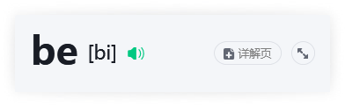
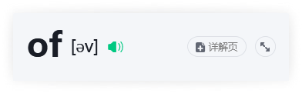
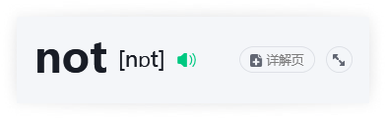
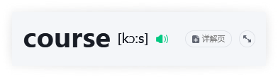
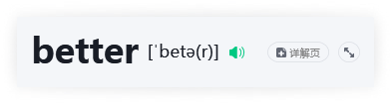
Emotional Response Expressions

Slide 13
04
Emotion Dialogues in Action
Step into roles — feel, speak, and care like real friends

Slide 14



Caring Conversations in Real Life
When a Friend Is Ill
When Someone Misses Home
When Class Feels Boring
■ Core Expression：Are you feeling okay? Do you need anything?
■ Why it works：Gentle tone + open-ended question shows concern without pressure.
■ Extra tip：Add 'I can help with...' to offer concrete support (e.g., 'I can bring you notes from class.')
■ Core Expression：Do you miss your family? Want to talk about them?
■ Why it works：Validates emotion + invites sharing → builds emotional safety.
■ Extra tip：Use past-tense questions to trigger positive memories (e.g., 'What’s your favorite thing to do together?')
■ Core Expression：Are you feeling bored? What would make this more interesting?
■ Why it works：Names the emotion honestly + shifts focus to collaborative solution.
■ Extra tip：Pair with light humor ('Same! Should we invent a superhero version of this topic?') to reduce tension.

Slide 15
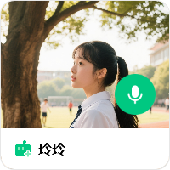

Slide 16
05
Knowledge Check & Fun Challenge
Let’s sort, speak, and feel — turn emotions into understanding!

Slide 17
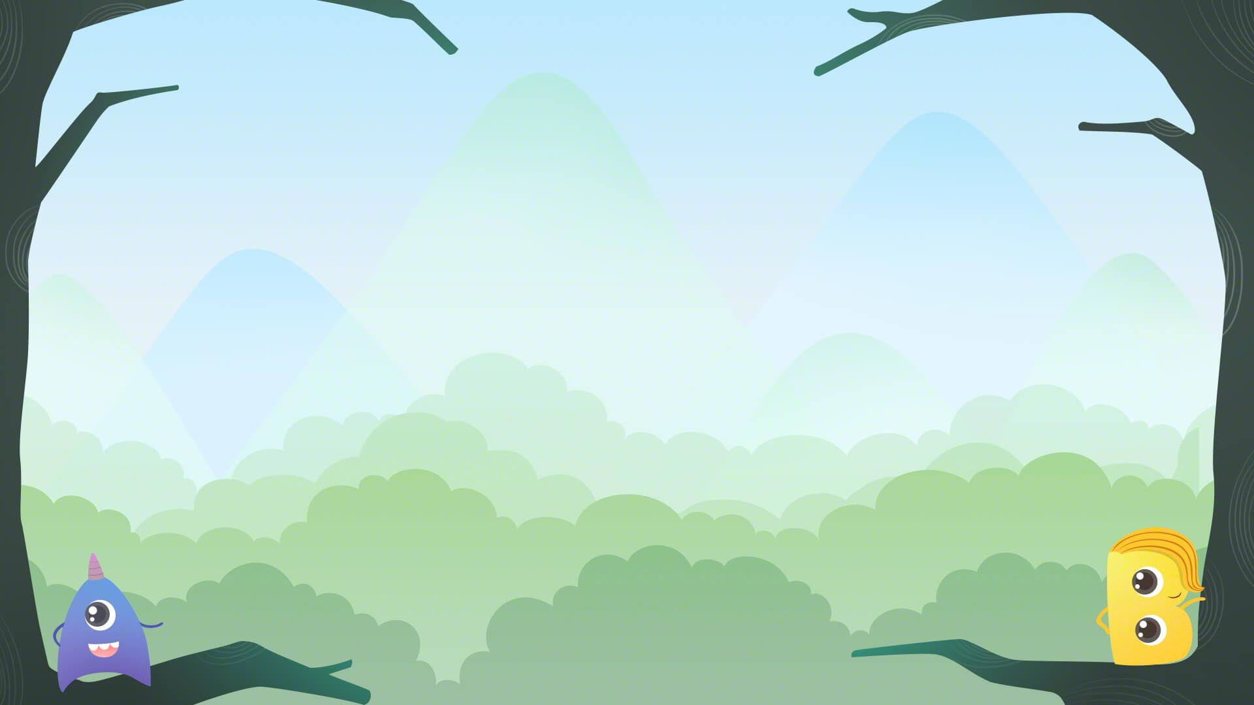









Slide 18
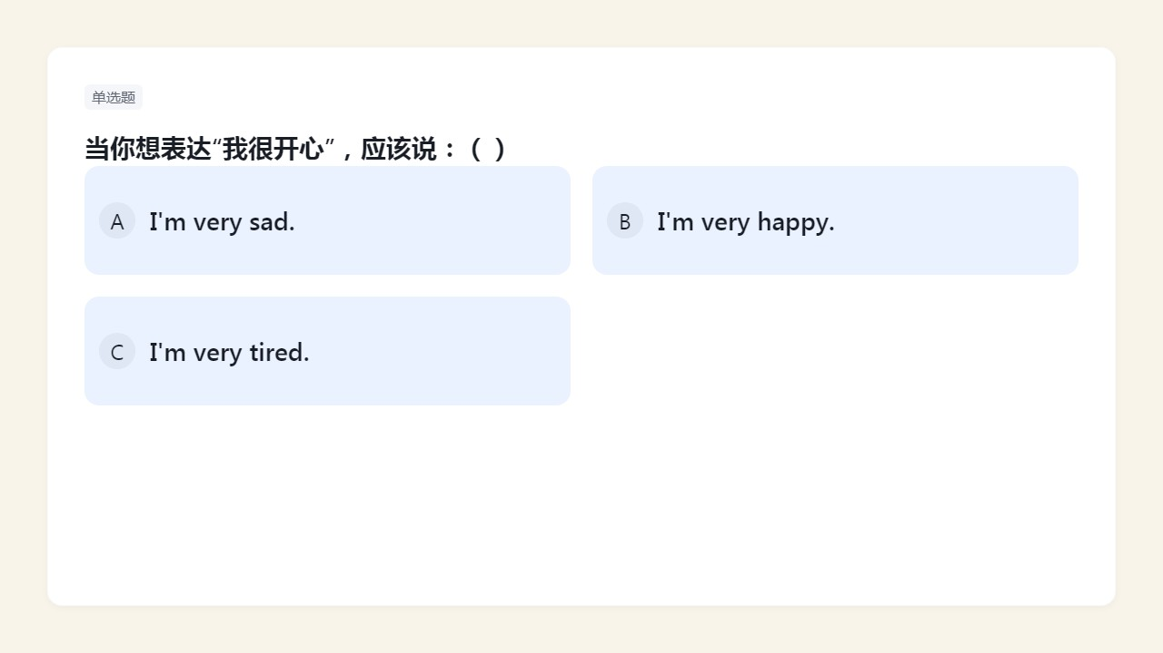


Slide 19
06
Unit Summary & Real-Life Transfer
From classroom language to caring communication in daily life

Slide 20

Ask Your Friend: Are You Feeling…?
■ Real Talk in Daily Life：
① Are you feeling bored? → "No, I’m not. I’m reading a great book!"
② Are you feeling sad? → "Yes, I am. My pet fish died this morning."
③ Are you feeling angry? → "Yes, I am. Someone took my seat without asking."
④ Are you feeling happy? → "Of course! I just got an A on my science test!"
■ Pro Tips for Natural Use：
● Always match your tone with the emotion — soft voice for sad, cheerful for happy
● Add follow-up questions: "What happened?" or "Do you want to talk about it?"
● Use body language: smile when asking about happiness, gentle eye contact for concern
※ Your words can be the first step toward someone’s better day.

Slide 21

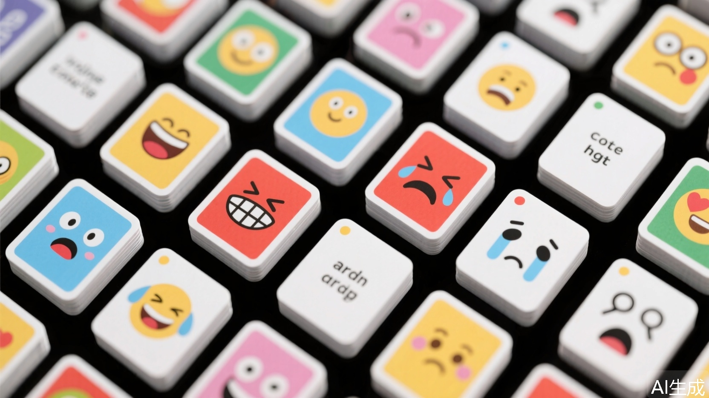
Be an Emotion-Wise Warmth Messenger
I notice my own feelings
★ Pause and name it: "I feel frustrated because the math problem is hard."
★ Track patterns: Do I feel tired every Monday? Excited before art class?
★ Journal one sentence daily: "Today, I felt ______ when ______."
1
I read my friends’ expressions
★ Observe clues: slumped shoulders = tired or sad; quick laughter = happy or relieved
★ Ask with care: "You seem quiet — are you okay?" instead of "Why are you so grumpy?"
★ Respect silence: Sometimes listening matters more than speaking.
2
I speak warmth in English
★ Choose kind phrases: "I’m sorry that happened." not "That’s not a big deal."
★ Offer real support: "Can I help you study?" or "Want to walk together after class?"
★ Celebrate small wins: "You tried hard — that’s awesome!"
※ Language isn’t just grammar — it’s how we hold space for each other.
3

Slide 22
Thank you!

